Slide 1

QUAD-COPTER AUTO-LEVELING DRONE FOR SURVEILLANCE
THESIS FINAL PRESENTATION
TEAM MEMBERS
NEWAY YIFRU ID NO:- EECER/0031/06
DEGITU ABEBE ID NO:- EECER/0013/06
KERAJ SHIFERAW ID NO:- EECER/0017/06

Slide 2
Content of presentation
Introduction
Literature Review
Methodology
Result and future work
Conclusion and recommendation

Slide 3
INTRODUCTION
Quadcopter is a multicopter lifted and propelled by four rotors
This project “Quad-copter auto-leveling drone’’ is design for surveillance and tourism
The drone has an auto-leveling system attached to it
so as to level the drone once the transmitter stick is released, this is until the stick is actuated

Slide 4
PROBLEM STATEMENT
In case of surveillance systems,
  In Ethiopian airlines the surveillance system is controlled using cameras that are mounted in a specific area
  Some area are not confortable (hazardous) for human life for mounting cameras
Our proposed system enables to control the surveillance system of ET using flying drone

Slide 5
        GENERAL OBJECTIVE
To solve the surveillance problem in Ethiopian airlines by designing quadcopter.
SPECIFIC OBJECTIVES
To Develop an intelligent system that can
automatically level the quad copter
To design the circuit using arduino uno (atmega328p
To dig out the system mathematical model
To understand system dynamic equations and rotor dynamic
To Develop the overall circuit

Slide 6
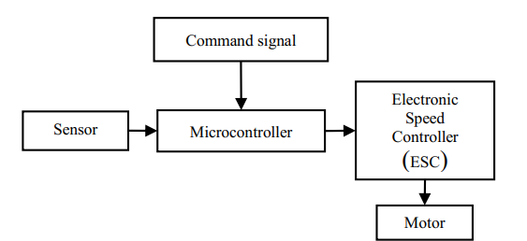
Methodology
Block diagram and procedure

Slide 7
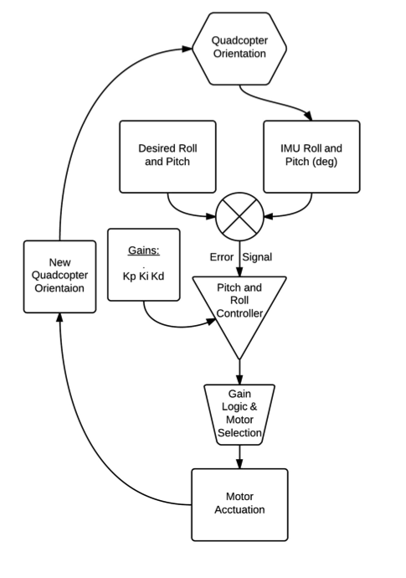
Cont.
Flowchart

Slide 8
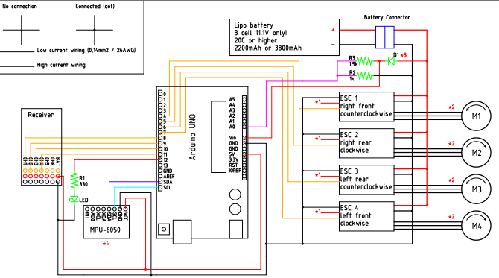
Circuit diagram

Slide 9
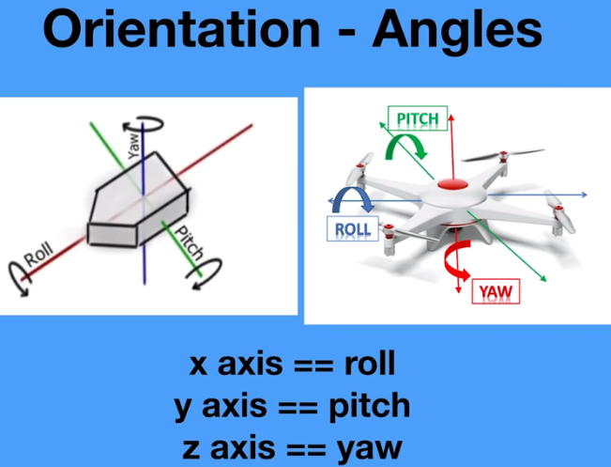
ORIENTATION

Slide 10
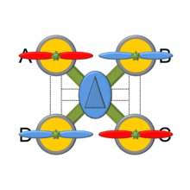
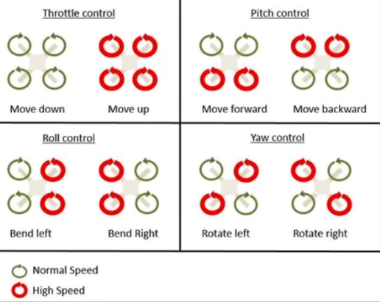
AERODYNAMICS
The propellers are designed such a way to create the pressure differences

Slide 11
Mathematical modeling
Coordinate Systems
    The quadcopter is navigating in a three dimensional space
    The BODY coordinate system (b) is a moving coordinate frame fixed to the quadcopter, with in the middle of the aircraft
    The origin of the inertial coordinate system is usually defined as the starting point on the ground where
    the quadcopter takes off.

Slide 12
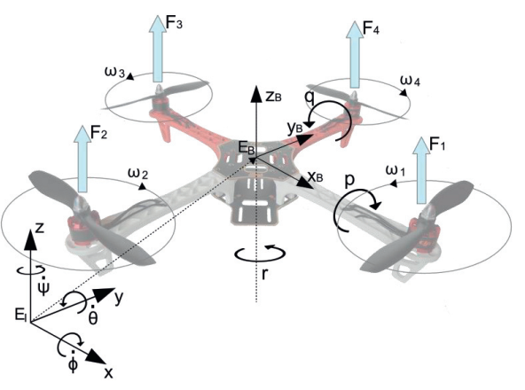
    The position of the quadcopter is defined as the position of the BODY origin with respect to the inertia coordinate origin

Slide 13
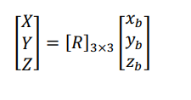

The rotation transformation matrix ZYX is used to transform the vector components from body axes to inertial frame of reference and vice versa
Where:

Slide 14



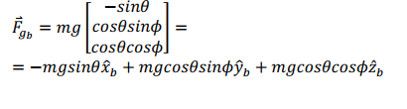
Equations of motion “Using Newton’s second law”
Translational equations of motion
  The thrust force vector in body axes for each motor is
  Force of gravity at body frame transformation is

Slide 15

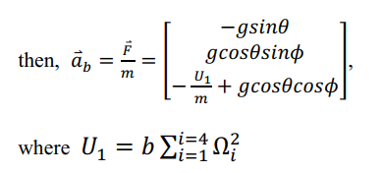
From this

Slide 16
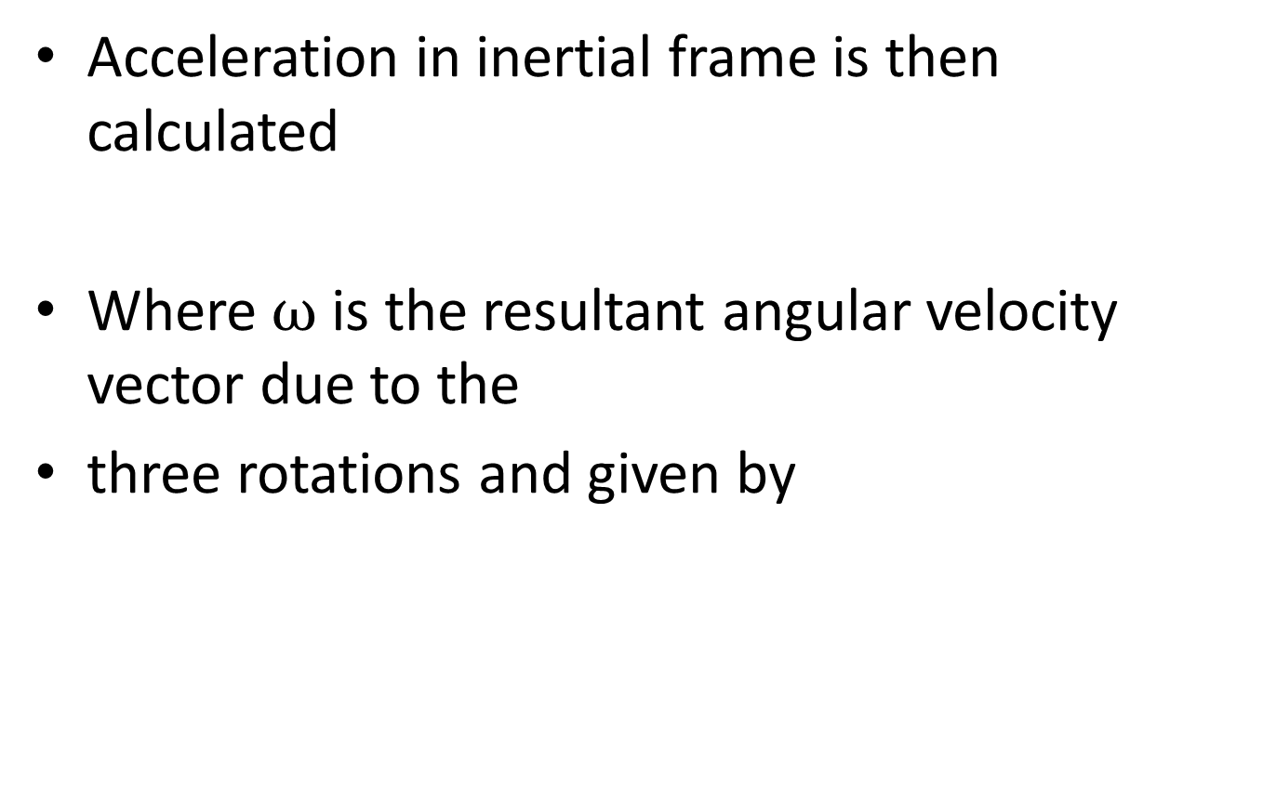

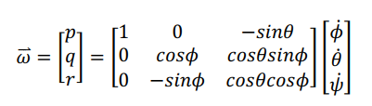
Cont.

Slide 17

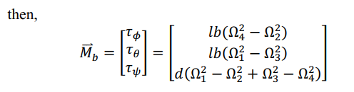
2. Rotational equations of motion
Mb = J ω ̇ + ω × J ω + MG
Where MG Gyroscopic moments due to rotors’ inertia; are defined to be ω × [0 0 JrΩr]T,
The moment vector Mb can be derived as the following:
Torque results from differential Ω:

Slide 18
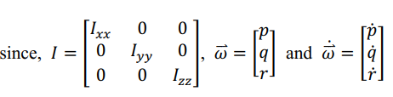
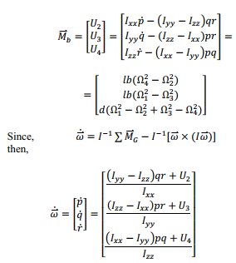
cont.
The moment vector in body axes then, new start thesis.docx

Slide 19

Linearizing
  to get the linear open loop transfer function. Linearization is made at hovering condition where
  For implementation, it is required to transform the control action into angular velocity for each motor
  Then, the linear open loop transfer functions are:

Slide 20
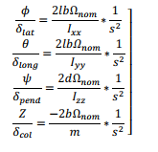
Cont.

Slide 21
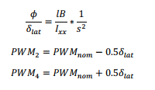
Analysis
It is clear that the angular velocity cannot be controlled directly in contrast with PWM signal, thus a relation between the PWM signal and the motor thrust force is required, so it’s assumed that Ti = b∗ Ωi^2 = B ∗ PWMi ,
where PWM is in (Micro sec) and
B is the motor constant that relates the motor thrust force with PWM and its value is obtained experimentally,
we take that data as assumption for our project

Slide 22
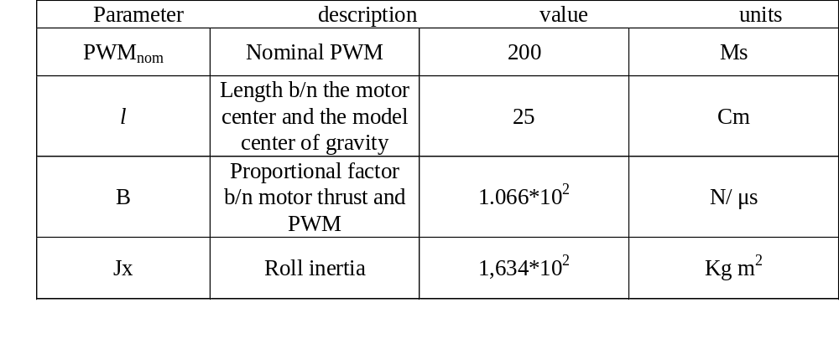
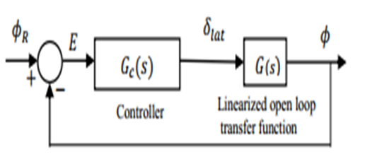
Parameters

Slide 23



Slide 24
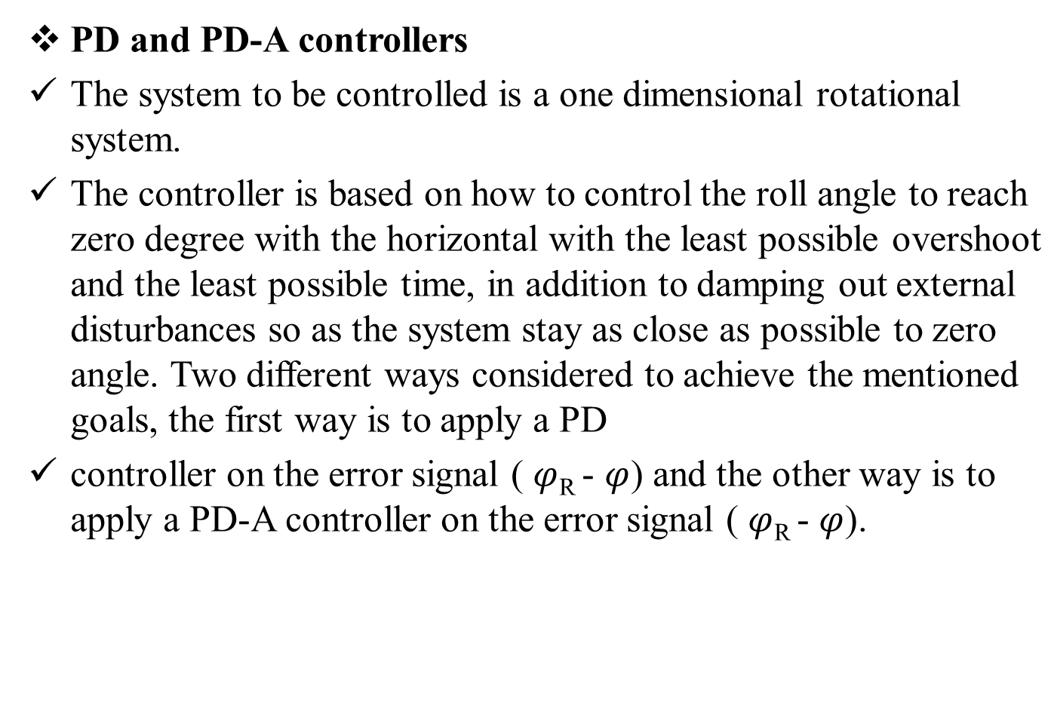

Slide 25





Slide 26

If we used gains Kp= 300 , Kd= 777 , then the controller transfer function will be:
this applied for PD-A and the step response is better when compare with PD controller

Slide 27
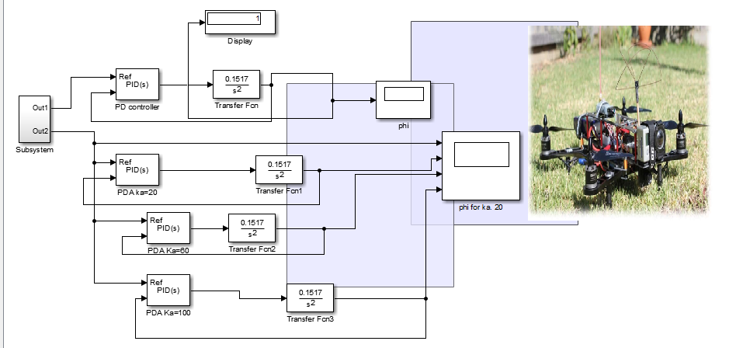
simulation circuit

Slide 28
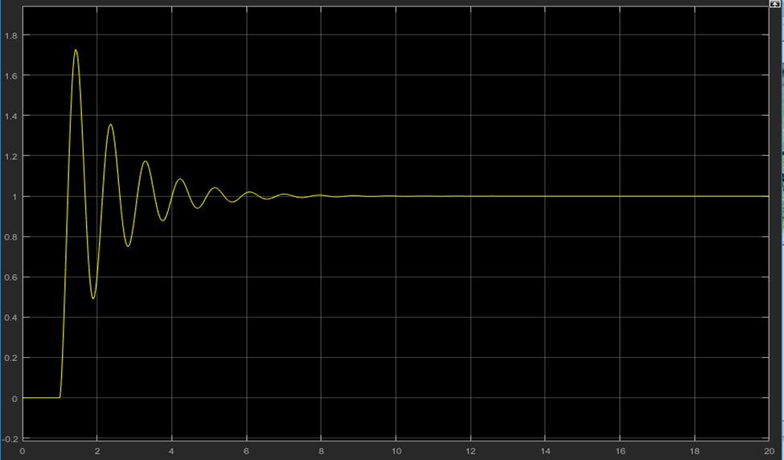
Result and future work
To clarify the theoretical difference between PD and PD-A controllers, a unit step response of the linearized system using PD controller with Kp = 300 and Kp = 10 (where PD controller is obtained when Ka = 0) and PD-A controller with gains Kp = 300, Kp = 10 and Ka = 20, &60 shown in Fig below from Simulink
PD control step response

Slide 29
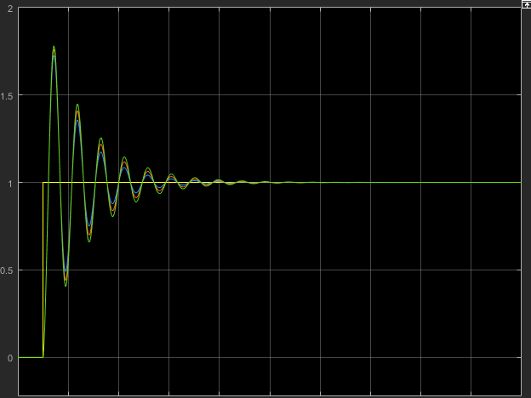
PD-A response with Ka=20

Slide 30
Conclusion
Quadcopter is very unstable system, so the challenge is difficult but it is also interesting system to imagine air flight control.
Generally to have stable and accurate flight the propellers and instruments have there own capability of working.

Slide 31
REFERENCES
Dhriti Raj Borah, “A review on Quadcopter Surveillance and Control”, ADBU- Journal of Engineering Technology, 4(1), 2016, 116-119
2. Prof.A.V.Javir, Ketan Pawar, Santosh Dhudum, et al., “Design, Analysis and Fabrication of Quadcopter”, Journal of The International Association of Advanced Technology and Science, vol. 16, 2015
3. Ankyda Ji1 and Kamran Turkoglu, “Intelligent Control and Navigation of an Indoor Quad-copter”, IEEE, 2014, 1700-1705.
4. Pooja Srivastava, Tejaswi Ninawe, Chitral Puthran, and Vaishali Nirgude, “Design and Implementation Quadcopter for Rescue Operations”, American Journal of Engineering Research, 5(9), 2016, 130-138. UAV”, IOSR Journal of Mechanical, 13(5), 2016, 73-76
5. www.arduino.cc

